Slide 1
SCHOOL OF APPLIED AND LIFE SCIENCES
Lesson Plan (2025-26) Even Semester
Introductory Lecture Lecture - Zero
Name of Faculty: Ms. Anjali Naudiyal
Location of Faculty
School Name: School of applied and Life Sciences

Slide 2
About the course
Course Name : Programming In C
Course Code : TBFS – 157
L-T-P structure : 3-0-0
Weekly Engagement : 3 Lecture
Course objectives:
To write algorithms, flowcharts and programs. .
To implement different programming constructs and decomposition of problems into functions.
To use and implement data structures like arrays and structures to obtain solutions.
To define and use of pointers with simple applications.

Slide 3

To be at the zenith in the field of Applied and Life Sciences by nurturing scholars through excellence in teaching, learning and research with concern for environment and society.

Slide 4
Mission (School of Applied and Life Sciences)
To Provide an educational environment where students can realize their full potential to attain professional skills and knowledge to face the challenges of the future.
To develop competence in diversified areas to create excellence in academic, research and placement.
To establish networks collaborations with industries, academic and research organizations to develop curriculum as per need of Industry and society.
Harness the skills of the students and assist them to excel in their career by providing sound theoretical knowledge, hands on training, exposure to research and seminar.
To Inculcate moral and ethical values for professional and social life.

Slide 5
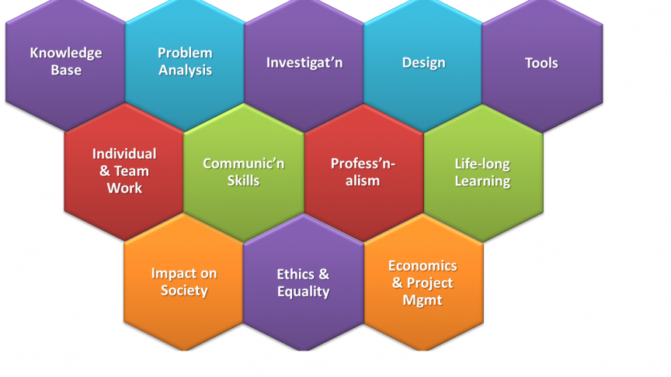
Graduation Attributes

Slide 6
PROGRAM OUTCOMES (POs)
PO-1 Disciplinary Knowledge: Gain the knowledge of chemical and life sciences and to apply this knowledge in related field.
PO-2 Critical Thinking: Identify, collect information, analyze data provided and substantiate conclusions for societal benefit.
PO-3 Problem Solving: Identify, formulate and analyze complex problems reaching substantiated conclusions using principles of mathematics, natural sciences, and life sciences.
PO-4 Analytical Thinking: Ability to think critically, analyze data and make difficult decisions and solve complex problems. .
PO-5 Individual and team work: Function effectively as an individual, and as a member or leader in diverse teams, and in multidisciplinary settings..
PO-6 Communication skills: Communicate effectively regarding scientific developments with society at large. Be able to comprehend and write effective reports and design documentation, make effective presentations, and give and receive clear instructions. .
PO-7 Moral & Ethical Values: Apply ethical principles and commit to professional ethics and responsibilities. Apply reasoning informed by the contextual knowledge to assess societal, health, safety, legal and cultural issues.
PO-8 Information and digital skills with Modern tool usage: Create, select, and apply appropriate techniques, resources, and use modern scientific tools for analysis of data.
PO-9 Experimental Learning: Learning through lab work in a smooth and efficient manner.
PO-10 Environment and sustainability: Understand the impact of the scientific solutions in societal and environmental contexts, and demonstrate the knowledge of, and need for sustainable development.
PO-11 Employability: Acquire a set of skills and key personal attributes which are highly valued by employers and essential for effective performance in the workplace.
PO-12 Life long learning: Recognize the need for, and have the preparation and ability to engage in independent and life-long learning in the broadest context of scientific advancement.

Slide 7
PROGRAM EDUCATIONAL OBJECTIVES (PEOs)
PEO-1 To demonstrate proficiency in statistical analysis of data.
PEO-2 To execute statistical analyses using professional statistical software.
PEO-3 To demonstrate skill in data management and develop the ability to build and assess data-based models.
PEO-4 To apply data science concepts and methods to solve real-world problems and effectively communicate their solutions.
PEO-5 Graduates will adhere to professional ethics, values, standards, and social responsibilities to contribute towards a better and more sustainable future.

Slide 8
PROGRAM SPECIFIC OUTCOMES(PSOs)
PSO-1 Graduates will become skilled data scientists in industry, academia, or government.
PSO-2 They will be able to utilize advanced software tools for data storage, analysis, and visualization.
PSO-3 Graduates will independently carry out research and investigations to solve practical problems.
PSO-4 They will develop a problem-solving approach and effectively present and communicate their output.

Slide 9
About the course (Programming In C)
This paper concludes the various important mathematical concept widely applied in computer.
Various concepts apply code reusability with functions and pointers.
This paper concludes different functions used in data handling and analysis.
Distinct approaches are used to understand the basics of file handling mechanisms.
Various algorithmic approaches are applied to solve the problems.

Slide 10

TBFS-157 CO1: Describe the fundamentals of C programming Language.
TBFS-157 CO2: Apply appropriate Control structures to solve problems.
TBFS-157 CO3: Write User defined functions and apply concept of recursion to solve problems.
TBFS-157 CO4: Describe the concept of Pointers and Structures.

Slide 11
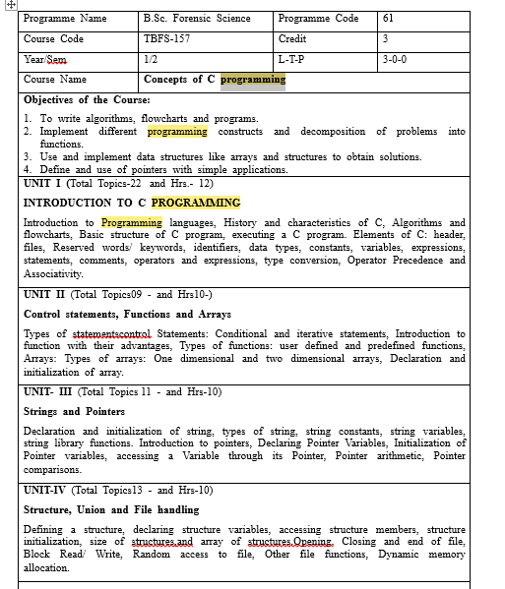
Syllabus of Programming In C

Slide 12
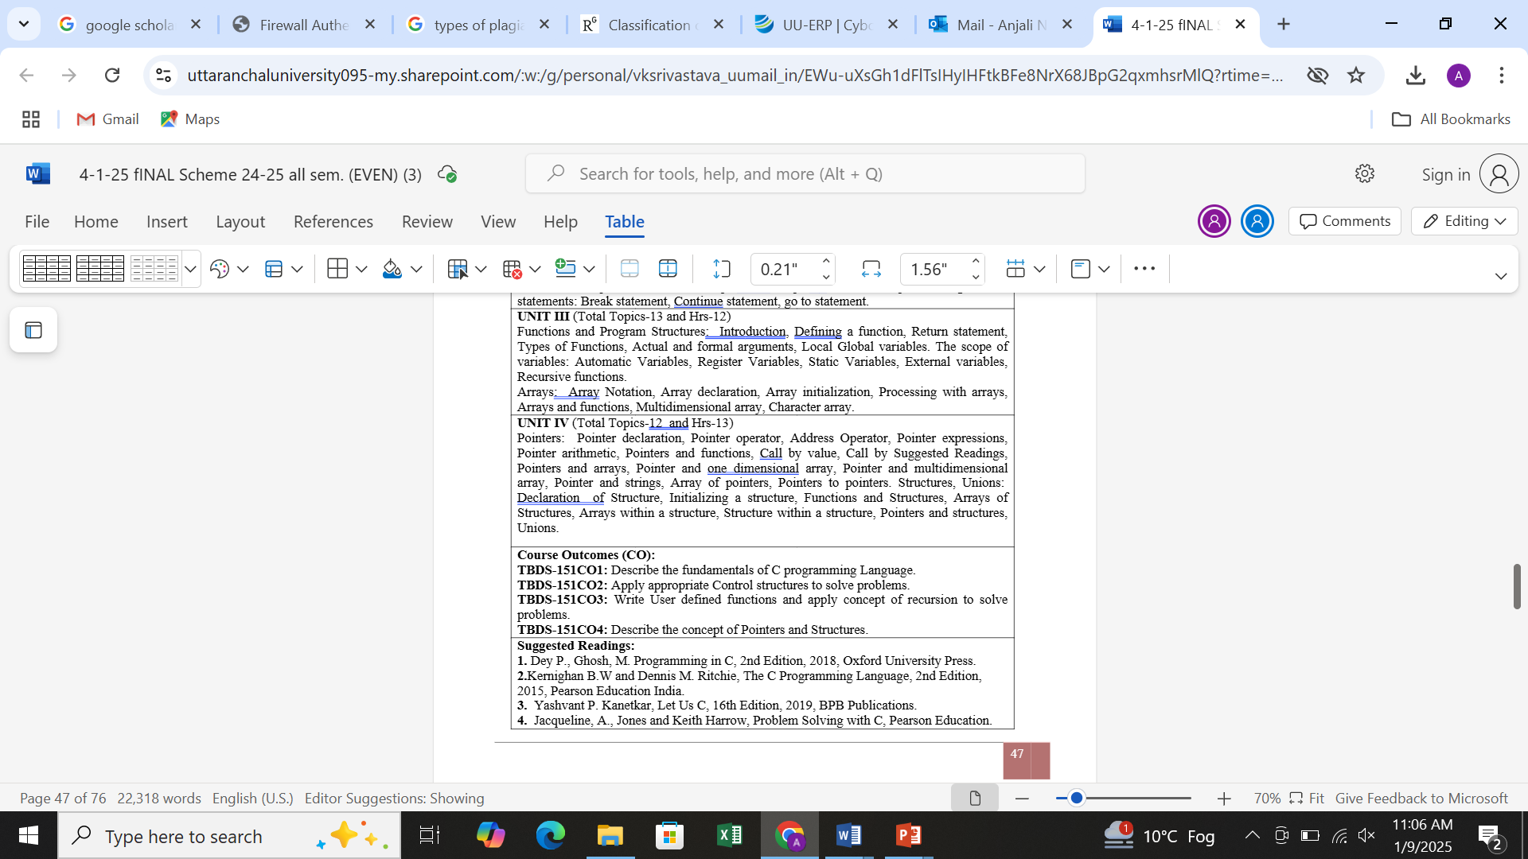

Slide 13
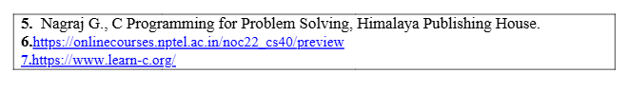
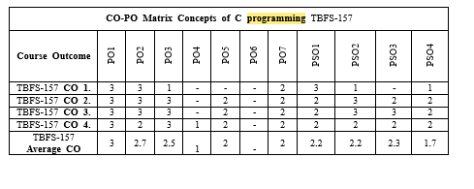

Slide 14
Assessment Process (Theory and Practical)
Internal : 20 Marks
Teacher Assessment: 20 Marks
External : 60 Marks
Internal Practical : 25 Marks
External Practical : 25 Marks

Slide 15
Attendance Requirement
Minimum: 75%

Slide 16
Books/ Journals/Website/Associations
Reference Books:
1. Dey P., Ghosh, M. Programming in C, 2nd Edition, 2018, Oxford University Press.
2. Kernighan B.W and Dennis M. Ritchie, The C Programming Language, 2nd Edition, 2015, Pearson Education India.
3. Yashvant P. Kanetkar, Let Us C, 16th Edition, 2019, BPB Publications.
4. Jacqueline, A., Jones and Keith Harrow, Problem Solving with C, Pearson Education.
5. Nagraj G., C Programming for Problem Solving, Himalaya Publishing House.
6. https://onlinecourses.nptel.ac.in/noc22_cs40/preview
7. https://www.learn-c.org/

Slide 17
Feedback System
We collect the feedback on curriculum aspects and courses from the students on the daily basis. Periodic analysis is made by ERP through the student feedback and suggestions given by the students after every lecture delivery.

Slide 18
Thank you

